Slide 1
Lead the Industry for Knee Surgery Success

Slide 2
You got into orthopedic healthcare to raise the standard of care and help people reclaim the life they love.
However, your attention spans a wide range of procedures, with your primary focus rightly on conducting successful surgeries.
As your partner in patient care excellence, Knee Rehab Pros is focused on advancing your facility’s standard of care specifically for Knee Surgeries.

Slide 3
↑ Patient Outcomes = ↑ Facility Reputation
It's not only about better patient outcomes; it's about elevating your hospital or surgery center’s standard of care, and setting a new industry market.
Afterall, every patient’s success story is a testament to your hospital or surgery center excellence. (One of the best forms of advertisement!)

Slide 4
Most facilities are unknowingly missing the mark when it comes to early post-operative knee care
✗ Inconsistent post-operative rehabilitation instructions
✗ Your results reliant on the patient closely following the uncomfortable recovery recommendations at home
✗ Patients regain less than satisfactory function post-surgery:
24% fall within the first year
18% walk slower
51% have more difficulty climbing stairs
99% never regain optimal quadriceps strength, typically maxing out at a 20-25% deficit.
Inability to descend stairs (100°), lift grandchildren (117°), garden (125°), tie shoes (106°) and other activities they need and love.

Slide 5
A Transformative Discovery
After a combined 30+ years as an Orthopedic Surgeon and Knee Therapist, we discovered that a majority of knee surgery patients were not maximizing the small window of opportunity following surgery (1-2 weeks post-operation) to fully reclaim their function.
With extensive research and testing, we discovered that if immediate post-operative care, and inpatient and outpatient rehabilitation prioritized preventing edema (swelling), patients could regain maximum range of motion (knee flexion and extension) resulting in dramatically better results.
Swelling causes pain, stiffness, poor proprioception and a decrease in muscular contraction in the muscles surrounding the joint (Protective Shut Down) that prevents knee flexion and extension. If swelling is not prevented starting immediately after surgery, the ideal outcome is compromised.

Slide 6
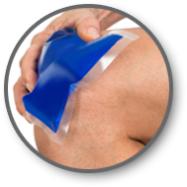
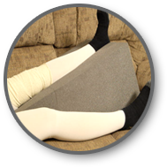
Introducing RIET Protocol
Edema control can give patients an advantage and a head start with rehabilitation. Edema control has been used for decades utilizing Rest, Ice, Compression, and Elevation (R.I.C. E.). Therefore, the best TKA protocol follows these principles:
Elevation
Therapy
Rest
“Limited activity” Instead of being up in a chair and walking constantly, patients are up only for therapy sessions, bathroom breaks, and when doing exercises.
Ice
In our setting this is achieved with a water circulating ice machine. And, there is a compression component when wrapping the ice pad around the knee.

Slide 7
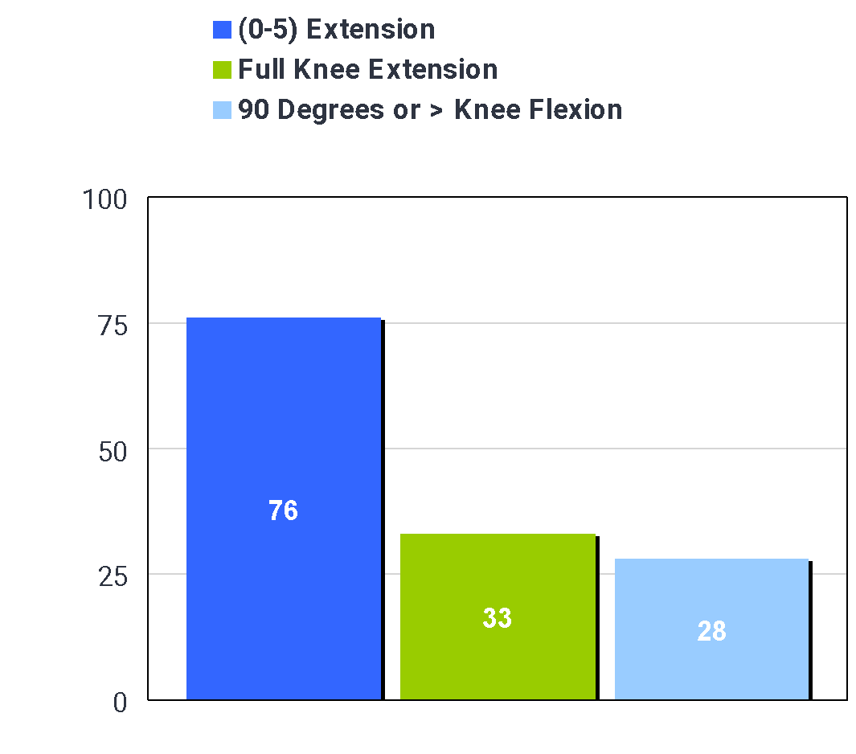
PROOF IN THE NUMBERS: Initial Data Collection
Data collection began in 2008 with TKA AAROM at hospital discharge. Initially we recorded knee extension (0-5 degrees) and knee flexion (> or = 90 degrees). No formal protocol utilized.
We discovered that only 33% of our patients were achieving full knee extension and our average knee flexion at hospital discharge was only 80 degrees.
 | (0-5) Extension | Full Knee Extension | 90 Degrees or > Knee Flexion | Average Knee Flexion
February 2008 N=9 | 44% | 22% | 0% | 67
March 2008 N=15 | 53% | 20% | 47% | 81
April 2008 N=27 | 81% | 30% | 30% | 76
May 2008 N=22 | 84% | 41% | 23% | 80
June 2008 N=17 | 94% | 41% | 29% | 79
July 2008 N=15 | 87% | 33% | 13% | 77
August 2008 N=19 | 79% | 26% | 32% | 84
September 2008 N=10 | 60% | 30% | 20% | 77
October 2008 N=8 | 100% | 25% | 38% | 85
November 2008 N=24 | 75% | 50% | 50% | 83
December 2008 N=19 | 79% | 42% | 47% | 88
Average | 76% | 33% | 28% | 80

Slide 8
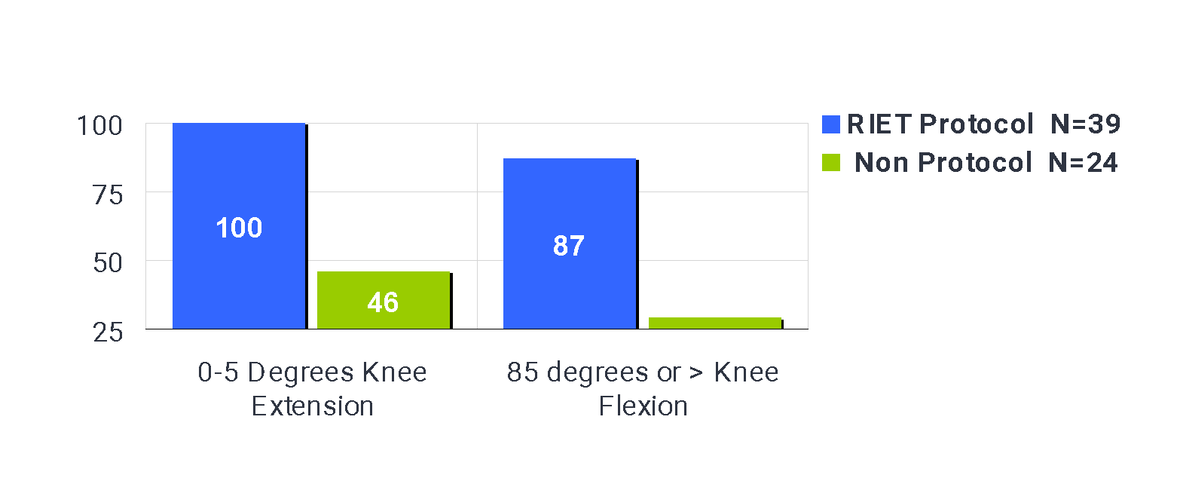
PROOF IN THE NUMBERS:
RIET Protocol vs Standard Processes
First Qtr of 2009: The RIET Protocol was implemented for a portion of the patients of one surgeon. We recorded active assisted range of motion (AAROM) for all of the patients of this single surgeon and compared the use of the RIET protocol versus the traditional TKA rehab (non-protocol). The differences were significant.
 | RIET Protocol N=39 | Non Protocol N=24
0-5 Degrees Knee Extension | 100% | 46%
85 degrees or > Knee Flexion | 87% | 29%

Slide 9
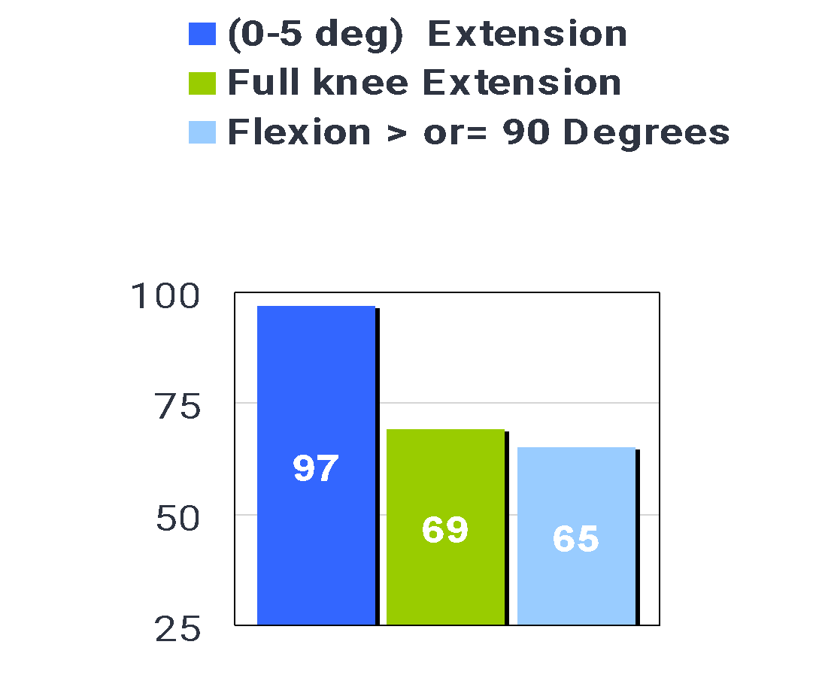
PROOF IN THE NUMBERS: After Improved Education & Goals
 | (0-5 deg) Extension | Full knee Extension | Flexion > or= 90 Degrees | Average Knee Flexion
January 2010 N= 32 | 97% | 72% | 56% | 90
February 2010 N=38 | 95% | 55% | 66% | 85
March 2010 N=33 | 100% | 67% | 64% | 89
April 2010 N=28 | 100% | 75% | 61% | 94
May 2010 N=25 | 96% | 67% | 60% | 91
June 2010 N=33 | 100% | 76% | 79% | 92
July 2010 N=16 | 100% | 56% | 69% | 90
August 2010 N=24 | 96% | 88% | 67% | 90
September 2010 N=32 | 97% | 81% | 66% | 91
October 2010 N=30 | 100% | 63% | 60% | 91
November 2010 N=43 | 95% | 56% | 65% | 86
December 2010 N=30 | 93% | 67% | 70% | 88
Average | 97% | 69% | 65% | 90
In 2010 we were providing better education to all staff members and upgraded our objective goals. We believed that full knee extension was critical and started tracking this data. We also increased our knee flexion goal to 90 degrees or greater. We continued to see improvements.

Slide 10
A Hold Up
The RIET Protocol was a clear success, but there was no good tool for comfortable, effective elevation - a critical step in RIET Protocol for preventing inflammation.
✗ The CPM, Boehler Pillow and foam blocks never kept the patient comfortably elevated in extension. They were okay for elevation, but patients were not getting their terminal extension back. And, they were reliant on families following very specific instructions during outpatient rehabilitation.
We needed something more effective and reliable for patients to maximize range of motion.
Notes:
Research against the CRM Machine: a Cochrane Review from 1966 to 2009 reveals little benefit for the use of the CPM. (2)
It is not detrimental; however, the machine:
Does not assist with full knee extension (the machine may read it is in full extension, but most patient’s knees are not straight while in the machine.)
Weighs 35 pounds. Many patient’s caregivers struggle to physically manage the machine.
Many patients and caregivers position the leg improperly in the machine which can ultimately do more harm than good.
Confines patients to the bed while using the machine.
Is not accommodating to patients who are large, short, or overweight.

Slide 11
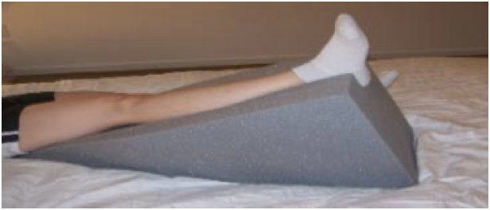
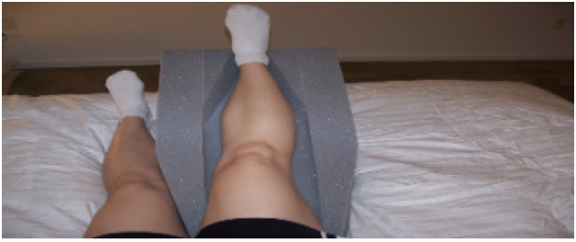
Introducing The LRU Pillow
The scientifically-designed LRU Pillow is proven to help a postoperative patients comfortably elevate their knee while holding it in terminal extension (keeping it as straight as possible) to mitigate swelling and maximize knee motion early. It is designed to be a user-friendly tool to make the the transition simple and increase adherence to the RIET Protocol:
✓ Elevation to achieve edema control
✓ Positioning to encourage knee extension while resting
✓ Light-weight
✓ Accommodate various patient sizes
✓ Allows for use in recliners, sofas, beds, etc.
✓ Capability of use during the entire recovery process.
Implementing the RIET Protocol using the LRU Pillow at your hospital enables consistent, industry-leading results for your knee surgery patients. The LRU pillow must be placed under the patient's knee immediately following surgery and used throughout impatient and outpatient care for optimal recovery.
Notes:
The LRU Pillow was initially designed for the rehabilitation of total knee arthroplasties. We are finding similar success with other diagnoses:
Proximal Tibia Fractures
Femur Fractures
Patella Fractures
ACL Reconstruction
Foot/Ankle Surgeries
Venous Disease
Lower Extremity Burns

Slide 12
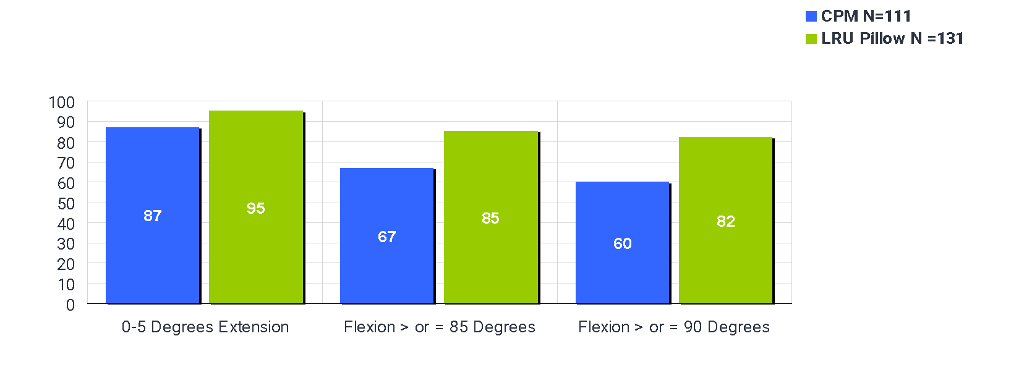
PROOF IN THE NUMBERS: LRU Pillow vs CPM
In 2011 we examined the efficacy of using the CPM machine. We introduced an alternative elevation device that focused on knee extension at rest called the LRU pillow. We yielded better extension and flexion results when using the LRU pillow.
 | CPM N=111 | LRU Pillow N =131
0-5 Degrees Extension | 87% | 95%
Flexion > or = 85 Degrees | 67% | 85%
Flexion > or = 90 Degrees | 60% | 82%

Slide 13
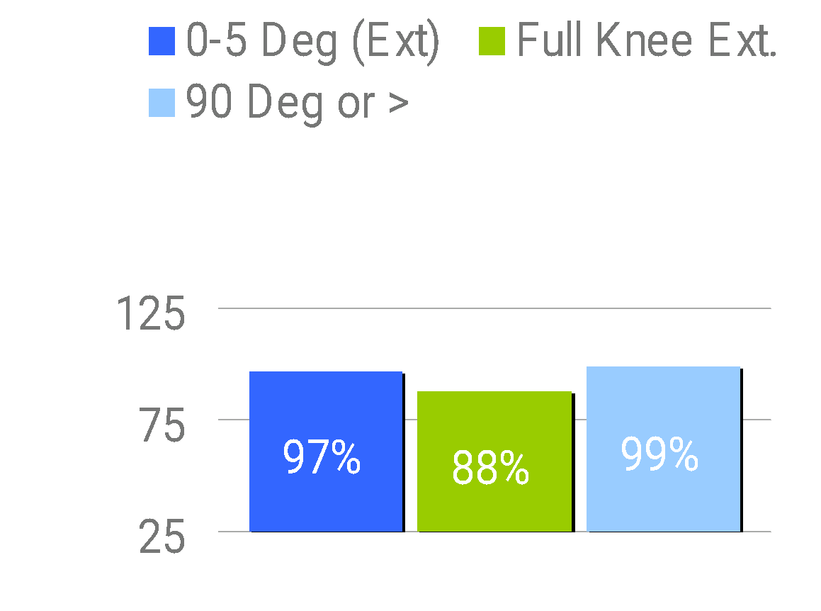
PROOF IN THE NUMBERS: After RIET Protocol & LRU Pillow
 | 0-5 Deg (Ext) | Full Knee Ext. | Flexion 90 deg. Or > | Avg. Knee Flexion | Avg. PT Tx's
March 2012 N=4 | 75% | 75% | 100% | 114 | 3
April 2012 N=16 | 94% | 81% | 94% | 112 | 4
May 2012 N=14 | 100% | 64% | 100% | 110 | 4
June 2012 N=12 | 100% | 100% | 100% | 128 | 4
July 2012 N=13 | 100% | 85% | 92% | 111 | 4
August 2012 N=20 | 100% | 95% | 100% | 120 | 4
Sept. 2012 N=16 | 100% | 94% | 100% | 115 | 4
October 2012 N=24 | 100% | 92% | 100% | 114 | 4
November 2012 N=26 | 100% | 100% | 100% | 118 | 3
December 2012 N=33 | 100% | 91% | 100% | 117 | 3
Average | 97 | 88 | 99 | 116 | 4
In 2010 we were providing better education to all staff members and upgraded our objective goals. We believed that full knee extension was critical and started tracking this data. We also increased our knee flexion goal to 90 degrees or greater.
We opened a new hospital in 2012 and began treating TKA patients in March. We were CPM-free, using the LRU pillow exclusively and were able to educate all staff members on the RIET protocol. By the end of 2012, 88% of our patients were achieving full knee extension at hospital discharge and our average knee flexion was 116 degrees.

Slide 14
The Positive Trend Has Continued
By the end of January 2024, 97% of patients achieve full knee extension at hospital discharge and the average knee flexion is 118 degrees
due to the consistent implementation of RIET Protocol using the LRU pillow.

Slide 15
The Unparalleled Results
✓ Better pain control
✓ Minimal swelling
✓ Ability to more aggressively rehabilitate range of motion to a degree that allows them to do everything they enjoy (120 degrees)
✓ Time to regain strength and balance later (this window is not as small)
✓ Increase in practical function
✓ Faster and fuller recovery
✓ High praise for their surgeon and therapist

Slide 16
Achieving Early Knee ROM is
the Tip of the Iceberg
Early Range of Motion (ROM) is defined as ROM achieved in 1 to 2 weeks. This should be the focus of early post-operative care and rehabilitation.
Controlling edema is critical. Once swelling begins it is challenging to reverse jeopardizing ROM.
The RIET Protocol is an accelerated ROM program empowering patients to regain full range of motion during the short 1-2 week opportunity window following surgery.
If we do not achieve early ROM that allows function, therapy cannot and should not move into the higher level rehabilitation.
Once early ROM is achieved, then outpatient therapy can focus on Strength, Proprioception, Neuromuscular Re-education, Balance and Gait Quality, which do not have as small of a window.

Slide 17
Help Your Facility Set The Benchmark for Knee Surgery Outcomes
Step 1
RECEIVE A FREE KNEE REHAB KIT
The educational materials, case studies, success metrics, and a complimentary LRU pillow provided in the Free Discovery Kit will empower you to effectively demonstrate its advantages to your orthopedic surgeon and purchaser.
Step 2
PURCHASE LRU PILLOWS FOR YOUR FACILITY & IMPLEMENT RIET PROTOCOL
Purchase LRU Pillows for your facility to effectively implement the post-operative RIET Protocol.
Send each patient home with this essential tool and a RIET Protocol Packet upon discharge to facilitate a seamless continuation of optimal rehabilitation at home.
Step 3
LEAD THE INDUSTRY FOR KNEE SURGERY SUCCESS
Like you, we are committed to the evolution of healthcare. Incorporating the LRU pillow into your patients' post-operative care will enhance their recovery experience and elevate your standard of care. This not only drastically improves the outcomes of your procedure, but also aligns your hospital or center with the highest industry standards.

